Slide 1


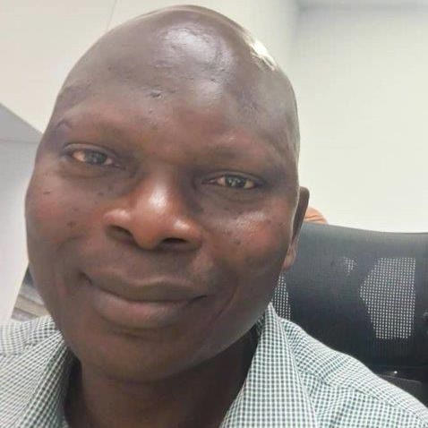
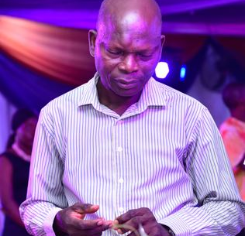
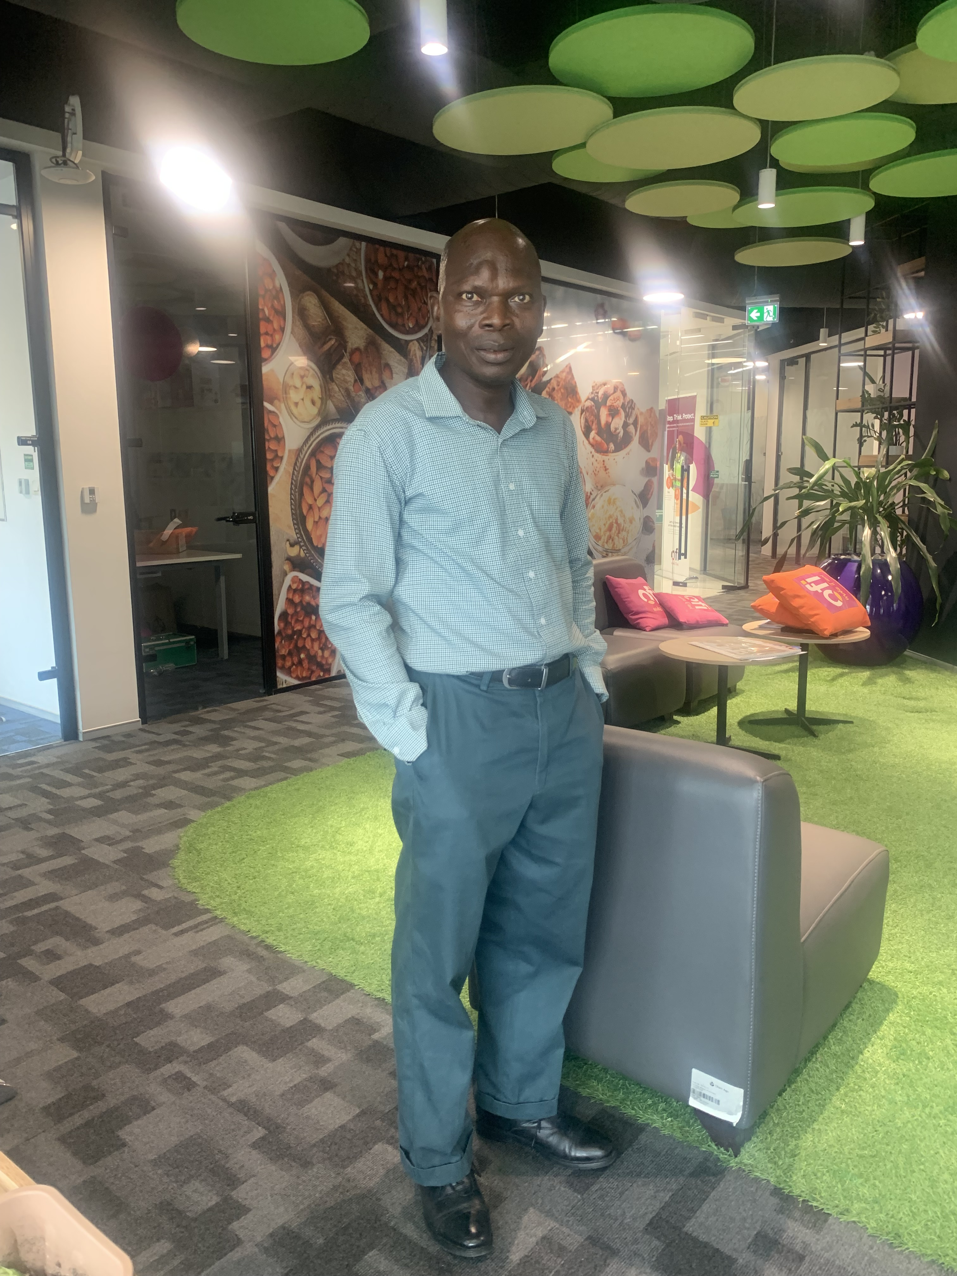
Getting to Know Me
Work
Personal
My role
Supply Chain Manager
Significant others / family members / furry friends in my life
Wife and Children
Tenure in ofi/Olam
30 years
How I enjoy spending my free time
personal Prayer and Meditation
Previous companies I have worked at
Have aways been here at Olam
My favorite / comfort food
Local Dish
Why I joined ofi/Olam and what keeps me here?
Passion for excellence
My favorite song
Quran recitation
Kazeem Salaudeen
‘what name you prefer to be called’
Alhaji Kazeem
This is me outside work, doing stuff I enjoy in my life …
A few fun facts about me
I love spending time Praying and my personal study / Research

